Slide 1
Silver to Grid Data Services Session II: Developing a Silver-Level Compatible Data Service API
caBIG™ Annual Meeting
June 23-25, 2008

Slide 2
Overview of Sessions I - III
Divided into three 1 hour 15 minutes sessions
Tuesday | Wednesday
10:15 - 11:30 a.m. | 10:00 - 11:15 a.m. | Session I: Overview of the Silver to Grid training program. Presentation and Live Demo of caGrid Semantic Interoperability.
12:45 - 2:00 p.m. | 12:30 - 1:45 p.m | Session II (Lessons 1-5): Developing a Silver-Level Compatible Data Service API
2:15 - 3:30 p.m. | 2:00 - 3:15 p.m | Session III (Lessons 6-9): Deploying a Data Service on caGrid and using caGrid Service APIs
Notes:
This is an overview of the overview slide
What is covered in the 3 sessions today and tomorrow.
Session 1:
Overview of the Silver to Grid training program. (Whats in the full hands-on training program and the short versions we present today)
Presentation and Live Demo of caGrid Semantic Interoperability. (What you will be able to do on the grid if you complete the full training. You should have the knowledge, tools and code to do the demo yourself.)
Sessions 2-3 are a short course with key highlights from the full course, not full details or examples, no hands on exercises or demos. This might be enough for some to get started.
Session 2:
Developing a Silver-Level Compatible Data Service API
Session 3: Deploying a Data Service on caGrid and using caGrid Service APIs

Slide 3
Acknowledgements
Peter McGarvey
Baris Suzek
Mike Keller
Dianne Reeves
George Komatsoulis
Avinash Shanbhag
Becky Angeles
Jennifer Brush
Jamie Parker
Claire Wolfe
Ken Smith
Sal Mungal
Virginia Hetrick
Shannon Hastings
Architecture/VCDE workspace participants

Slide 4
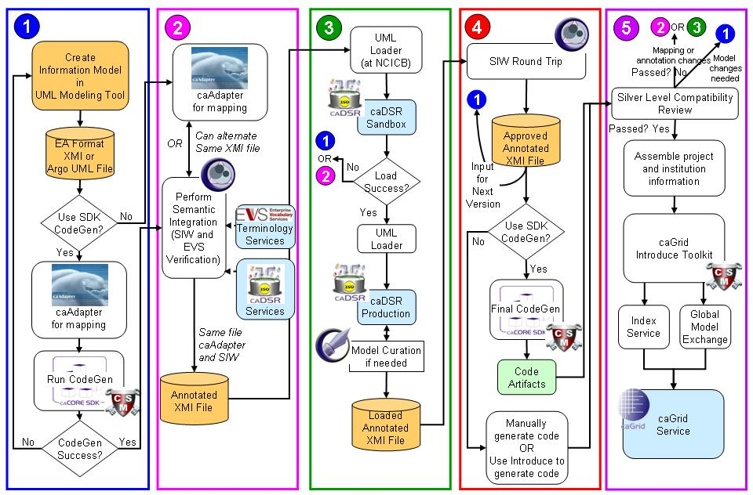
Session II: Developing a Silver-Level Compatible Data Service API
Notes:
Here again is the process to develop a silver level compatible service, it assumes you use the caCore SDK, you don’t have to use the SDK but we recommend it if you can.
Today we will cover steps involved in generation of a Silver-Level compatible data service API:
Information Modeling/Modeling your domain
Semantic Annotation
Loading Model to caDSR
Generating the API
Silver Level Compatibility Process

Slide 5
Session II: Lessons
Lesson 1: Modeling Your Domain in UML
Lesson 2: Semantically Annotating Your UML Model
Lesson 3: Transforming Model to caDSR Metadata
Lesson 4: Generating a caCORE-like System
Lesson 5: Using a caCORE-like System
Notes:
Session 2 today after lunch covers key steps this part of the process
Information Modeling
Semantic Annotation
Loading Model to caDSR
Generating the API
Silver Level Compatibility Process

Slide 6
Lesson 1: Modeling Your Domain in UML
Creating Your UML Model for caBIG™
Notes:
Welcome to Training. I am your trainer, __. The session actually starts at __pm EST. In the meantime, just sit tight until others get logged on.

Slide 7
Modeling Your Domain in UML
Notes:
Today we will cover steps involved in generation of a Silver-Level compatible data service API:
Information Modeling/Modeling your domain
Semantically Annotation
Loading Model to caDSR
Generating the API
Silver Level Compatibility Process

Slide 8
Overview
Outline
  Why Model?
  What is UML?
  How are caBIG™ models different?
  A real life scenario; modeling gridPIR data service
Objectives
  Provide an overview of caBIG™ modeling concepts and requirements
Notes:
Outline
Why Model?
What is UML?
How caBIG models are different?
Explanation of caBIG modeling concepts with an example; gridPIR data service
Here is the broad outline of this session.

Slide 9
Why Model?
Modeling achieves four aims:
  Helps you visualize a system
  Permits you to specify the structure or behavior of a system
  Guides you in constructing a system
  Documents the decisions you have made
Build models of complex systems because they are difficult to comprehend in their entirety
Build models to better understand the system you are developing.
The caBIG™ process and architecture is model driven, it is required for interoperability and silver level compliance.
Notes:
Why model?
Short answer is it is absolutely required and the first step in the caCORE process is to draw your system/project domain in UML. * The model, when semantically annotated and combined with service metadata becomes the foundation that allows the grid and grid services to programmatically discover and combine relevant information from different data services. This has to be done early and well and updated as you update your data service
Remember the model is not just for your application but for interoperability with others.
In addition is helps by
Helps you visualize a system
Permits you to specify the structure or behavior of a system
Guides you in constructing a system
Documents the decisions you have made
Additional reasons are:
Build models of complex systems because they are difficult to comprehend in their entirety
Build models to better understand the system you are developing.
The caBIG process and architecture is model driven, it is required for interoperability and silver level compliance
There are three parts to the system model: the logical model, data model, and data mapping model. The logical model describes the target domain and should be created in the logical package.* The Data Model describes the database schema* and the Object relational mapping maps classes to object. All of these are drawn in UML. Throughout this presentation, the terms “logical model”, “domain model” and “object model” are used interchangeably.*
caCORE SDK tools impose modeling guidelines* such as
Java naming conventions*
Package rules*
Element constraints*
For Example, *
*Only UML class diagram elements may be used
*Cannot use interface, object, etc.
Detailed instructions on creating diagrams in UML can be found in the SDK Programmer’s Guide.

Slide 10

What is UML?
UML is a language for
  Visualizing
  Specifying
  Constructing
  Documenting
  The artifacts of a software system.
UML allows you to build models that are precise, unambiguous and complete
There are many UML diagram types
  caCORE SDK utilizes one type, the UML Class Diagram
Notes:
Visualizing: Communicating conceptual models to others is prone to error unless everyone involved speaks the same language. There are things about a software system you can’t understand unless you build models. An explicit model facilitates communication.
Specifying: UML allows you to build models that are precise, unambiguous and complete. There are many UML diagram types. caCORE utilizes one diagram type: UML Class Diagram
Constructing: UML models can be directly connected to a variety of programming languages. Maps to Java, C++, Visual Basic, etc. Tables in a RDBMS or persistent store in an OODBMS Permits forward engineering Permits reverse engineering
Documenting: The UML addresses documentation of system architecture, requirements, tests, project planning, and release management.
There are many UML diagram types, however caCORE utilizes one diagram type – the UML Class Diagram
Throughout this presentation we only talk about the logical model the most critical one to get right for caBIG , the terms “logical model”, “domain model” and “object model” are used interchangeably.*

Slide 11
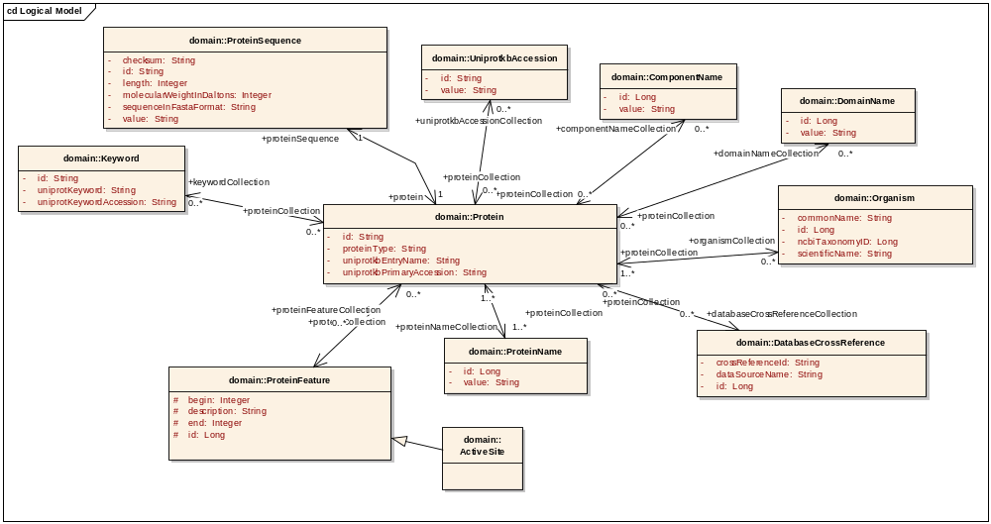
Components of a Class Diagram
ClassName
attributeName
Datatype
associationName
Multiplicity
Bi-directional Association
Generalization
Notes:
Here is a logical model. It contains
The UML diagram contains
- classes (see Protein)
- attributes (see Organism.commonName) with datatype
- associations with end point names, directionalities and multiplicities
-operations (not shown)

Slide 12
Which UML modeling tools can be used for caBIG™?
caCORE SDK is compatible with:
Enterprise Architect by Sparx Systems
http://www.sparxsystems.com/products/ea/index.html
ArgoUML (open source):
http://argouml.tigris.org
Notes:
Training uses EA.

Slide 13
How are caBIG™ models different?
caBIG™ services are expected to have a domain information model:
  A Domain Information Model is a representation of our understanding of an area of knowledge
  A Domain Information Model consists of ‘Classes’ that represent ‘things’ in the real world
  In a Domain Information Model, classes contain ‘attributes’ that are characteristics of different instances of things in the real world

Slide 14
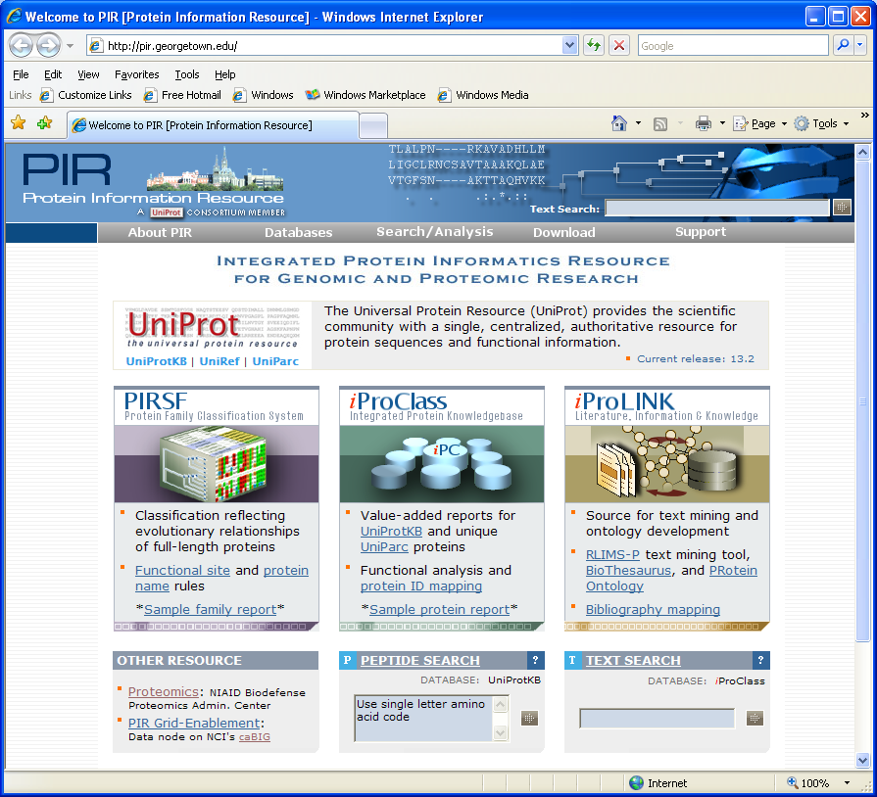
A real life data service:
Grid-enablement of Protein Information Resource (gridPIR)
The Protein Information Resource
PIR is an integrated resource for proteomic research.
gridPIR is currently a caBIG™ silver level compliant data service exposing information from one of the PIR databases, the UniProt Knowledgebase (UniProtKB)
gridPIR’s goal is to provide comprehensive and fully annotated protein sequence and functional information for basic cancer research
Notes:
Here and for the rest of these lessons we will us as an example work done with gridPIR
PIR is an integrated resource for proteomic research at Georgetown University.
gridPIR is currently a caBIG silver level compliant data service exposing information from on of the PIR databases, the UniProt Knowledgebase (UniProtKB)
Contains information for basic cancer research.
Its goal is to provide comprehensive and fully annotated protein sequence and functional information for basic cancer research.
How can we model this service?

Slide 15
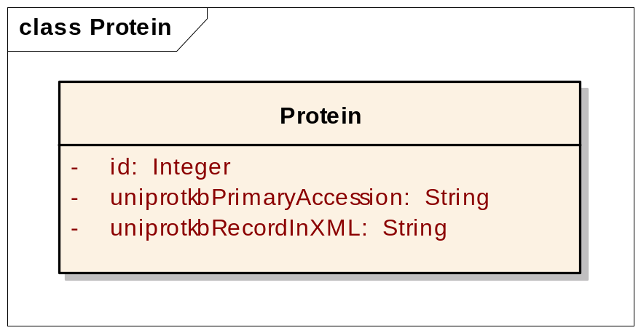
Modeling a real life data service: gridPIR
A not-so-recommended approach
Modeling Approaches: One object approach => Modeling the record using existing XML schema.
Is this valid? Yes
Is this a good model? Not for us
Is this a domain information model? No
P99999
<uniprot xmlns="http://uniprot.org/uniprot" xmlns:xsi="http://www.w3.org/2001/XMLSchema-instance" xsi:schemaLocation="http://uniprot.org/uniprot http://www.uniprot.org/support/docs/uniprot.xsd"> <entry dataset="Swiss-Prot" created="1986-07-21" modified="2007-01-23" version="44"> <accession>P99999</accession> <accession>P00001</accession> <accession>Q6NUR2</accession> <accession>Q6NX69</accession> <accession>Q96BV4</accession> <name>CYC_HUMAN</name> <protein> <name>Cytochrome c</name> </protein> <gene> <name type="primary">CYCS</name> <name type="synonym">CYC</name> </gene> <organism key="1"> <name type="scientific">Homo sapiens</name> <name type="common">Human</name> <dbReference type="NCBI Taxonomy" id="9606" key="2"/> <lineage> <taxon>Eukaryota</taxon> <taxon>Metazoa</taxon> <taxon>Chordata</taxon> <taxon>Craniata</taxon> <taxon>Vertebrata</taxon> <taxon>Euteleostomi</taxon> <taxon>Mammalia</taxon> <taxon>Eutheria</taxon> <taxon>Euarchontoglires</taxon> <taxon>Primates</taxon> <taxon>Haplorrhini</taxon> <taxon>Catarrhini</taxon> <taxon>Hominidae</taxon> <taxon>Homo</taxon> </lineage> </organism>
……
The valuable information is not exposed (e.g. protein annotation)
It needs to be exposed to be advertised and discovered on caGrid
Notes:
One very simple and not recommended approach is to model the entire record as one object.
Obviously this is an extreme example and not be used for your service. However a record object has been proposed in some cases were there is an already established and excepted community standard for xml transfer of information, is this case it would be one object in a larger information model and the objects use would be to transmit the record for a tool that needed that format for input.
Less extreme and the first approach we took and many others have tried with poor success is to reverse engineer the xml we already had.
This reverse engineering though tempting seldom works well as the xml formats are often designed for data or record transfer and may be great for that purpose but not the best for information modelling or attaching meaningful metadata or semantics
This can be true for applications existing UML models also.

Slide 16
Modeling a real life data service: gridPIR
A reverse engineering approach
Should You Reverse Engineer an Existing XML Model?
You can but it will not guarantee caBIG™ compatibility.
In practice reverse engineering existing models has seldom worked well in the context of caBIG™.
Reverse engineering an existing model can help in understanding the domain but in practice it has not always provide a good information model for caBIG™’s goals of interoperability. It is often been better to create a new or extensively modified version.
Notes:
Less extreme and the first approach we took and many others have tried with poor success is to reverse engineer the xml we already had.
This reverse engineering though tempting seldom works well as the xml formats are often designed for data or record transfer and may be great for that purpose but not the best for information modelling or attaching meaningful metadata or semantics
This can be true for applications existing UML models also.
So what do we need to consider in modeling?

Slide 17
Modeling a real life data service: gridPIR
Considerations
  Scientific meaning – Design a re-usable domain information model, not application-specific record model
  Use cases – Consider search criteria objects e.g. Protein, Gene, Database Cross references
  Data related constraints – Include only associations or objects based on your data. e.g. Gene to Protein, but not Protein to DNA Sequence as UniProt does not have DNA sequence only Xrefs to other data sources for DNA.
  Semantics – Express semantics and avoid using non-informative “type” attributes. For example: name the ProteinFeature subclasses, don’t assign a feature “type”.
  Reuse – Try to reuse existing models. Same “Things” can exist in other caBIG™ compatible models.
  caCORE SDK constraints – Consider naming conventions, “id” attribute for each class
Notes:
What do you want in a ‘good’ model.
SDK versions 1-3 required an “id” attribute version 4 will not.

Slide 18
Modeling a real life data service: gridPIR
Use cases
Retrieving protein information using:
  Simple search using only one criteria
  Advanced search criteria constructed using Boolean operators
  Database identifier search without providing data source
Search criteria can be based on:
  Database identifiers
  Protein sequence features (annotations)
  Protein/Gene name
  Keywords/Organism
Notes:
We are actually building a data service for a real world database called UniProt that collects and annotates information for a variety of other scientific databases and the literature, here are our use cases
Note that the use cases already asks for creation of certain classes (things in real life) and how they should relate to each other (associations)

Slide 19
Modeling a real life data service: gridPIR
Naming conventions/caCORE SDK constraints
Naming Conventions:
Adopt a case convention
  camelCase is recommended, some caBIG™ tools like the SIW support camelCase in mapping concepts.
Avoid using class identifiers in attribute names
Abbreviations and acronyms should be avoided
Avoid plural class or attribute names unless necessary
Add “Collection” to association ends with multiplicity >1 (no longer required but a good practice)
caCORE SDK constraints:
“id” attribute in classes (only caCORE SDK 3.0)
Avoid use of complex data types like “List” and “Collection”
Notes:
These are some current best practices at least in regards to the caCore SDK which has some technical constraints, not all is absolutely required but these can help speed the review process and avoid problems or more work later

Slide 20
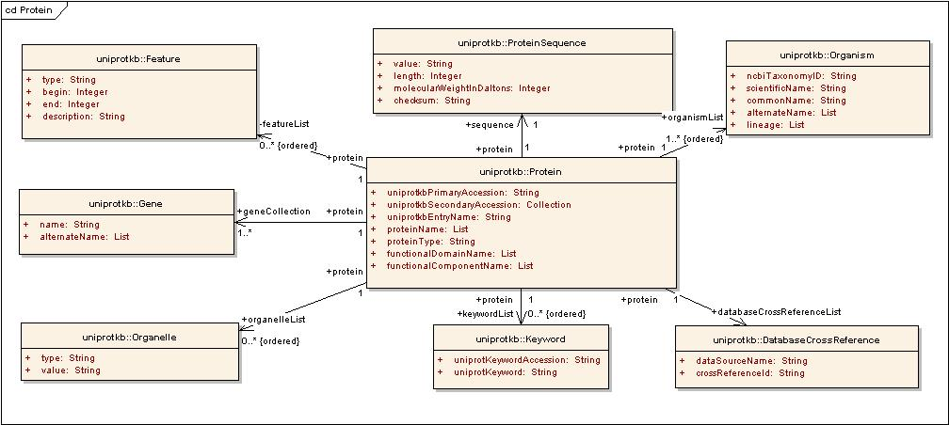
Modeling a real life data service: gridPIR
A so-so model
Good:
A pseudo-domain information model; classes are scientific real life things
Association directionality and classes based on use cases
Re-use of classes from available models; e.g. caBIO
Bad:
Attributes with complex data types
like list and collection.
Not all use cases are met
Semantics needs improvement
Violates some naming conventions
Notes:
What does this mean here is a better model but not good enough yet.
Complex data types like collection and string are not the most informative way to model and have some technical limitations in the SDK, more on that in the next slide
The feature object uses hides useful sematics and inhibits on of our use cases to search for all proteins with a particular ‘type’ of feature, more on that in a minute
The attribute proteinName in the class protein violates one of the naming conventions should just be called name, as you will see caBIG tools and services understand the name is in the context of the class protein.
Also the recommended convention for naming associations with multiplicity greater than 1 is Collection not used everywhere
If we look closer at the right side of this model – the Organism class should be curated further as demonstrated next.

Slide 21
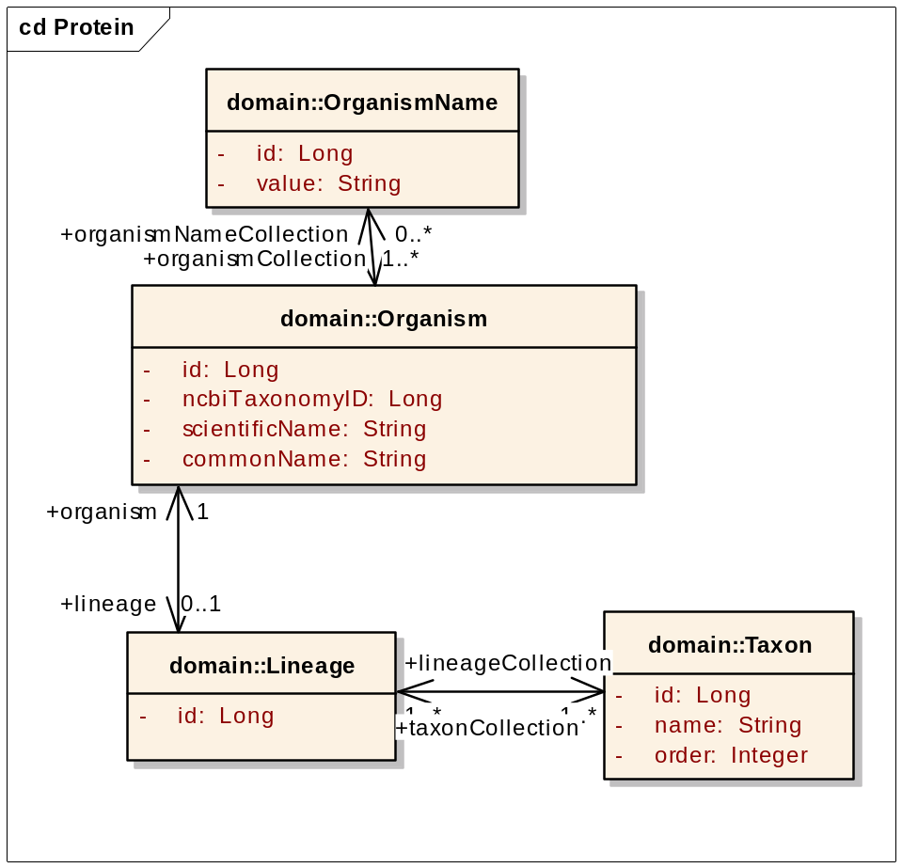
Modeling a real life data service: gridPIR
Improving Semantics Further
Break up lists into collections of separate objects so gridPIR can provide searches on:
  Lineage
  Taxon names
  Alternate names for Organism
Notes:
Complex data types like collection and string are not the most informative way to model and have some technical limitations in the SDK, they can make it difficult to search inhibiting some use cases,
they should be broken out into different objects

Slide 22
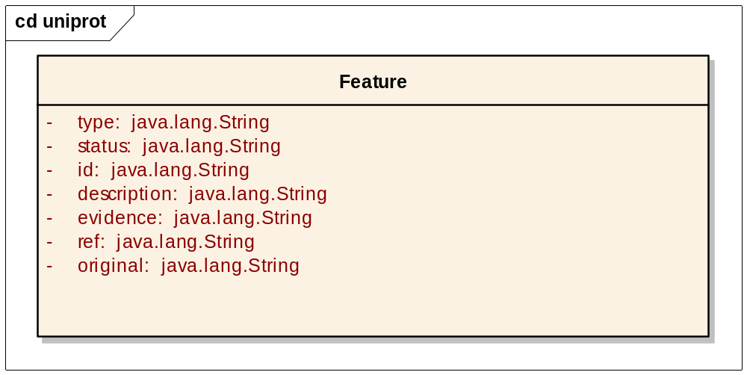
Modeling a real life data service: gridPIR
Improving Semantics Even Further
Important annotations in the protein sequence data are features which are regions or sites of interest in the sequence, including:
Posttranslational modifications
Binding sites
Enzyme active sites
Other functional domains
Problems:
Using “type” makes it difficult to discover gridPIR as a protein annotation resource
User needs to know permissible values for “type” to discover and even use the system
Solution was to create an individual class for each feature
Notes:
The feature object uses a attribute type to contain our ‘classification type name’ for different features like “binding site”, this hides very useful biological semantics and inhibits on of our use cases to search for all proteins with a particular ‘type’ of feature.

Slide 23
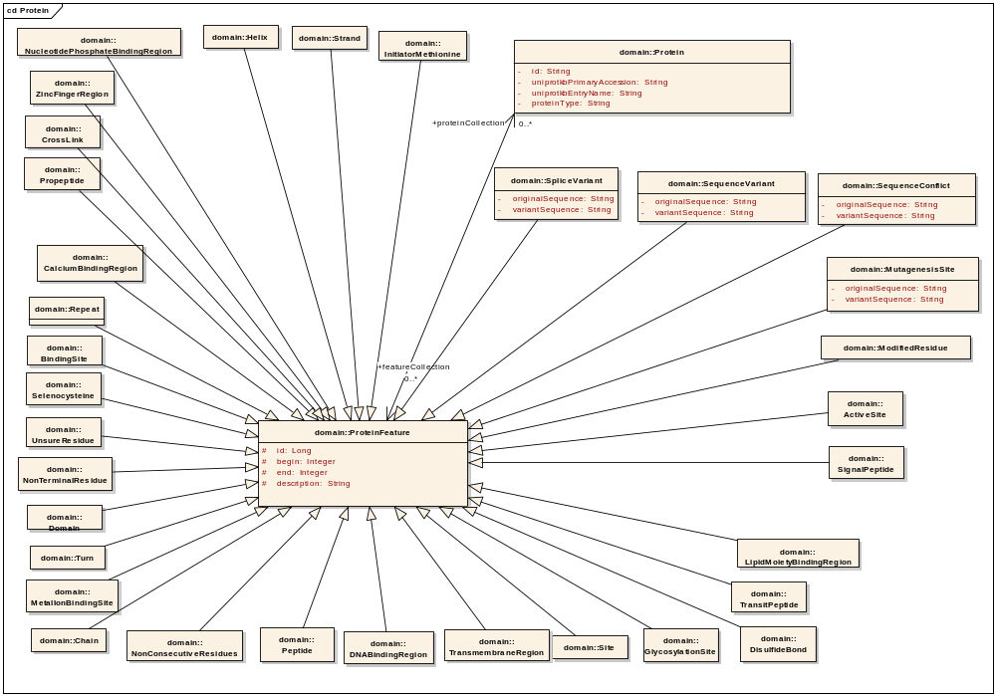
Modeling a real life data service: gridPIR
Improving Semantics Even Further
Protein Sequence Annotation Classes
Notes:
This tells me there are ActiveSites/BindingSites exposed by the data service.

Slide 24
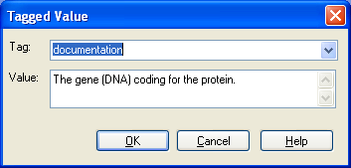
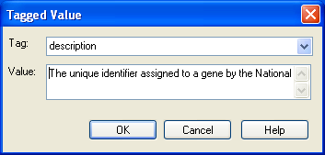
Modeling a real life data service: gridPIR
Improving Semantics
Using tagged values of UML tool
  Enter “documentation” for classes
  Enter “description for attributes
Documentation for a gene object
Description for a gene attribute, entrezGeneId
Notes:
To improve the system metadata, assist in the semantic annotation process and help anyone trying to understand and reuse your model you must also add tagged values
This information becomes part of metadata exposed as a part of caGrid Service Metadata, caDSR stored metadata.

Slide 25
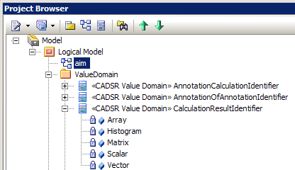
Modeling a real life data service: gridPIR Improving Semantics Even Further
Use enumerated value lists and model them in UML – a class with “caDSR Value Domain” stereotype:
If appropriate to your data service or application please see the developer boot camp presentation on this subject.
gforge.nci.nih.gov/docman/view.php/196/6025/02_Enumerated%20Value%20Lists%20JLB.ppt
Notes:
It limits the value set for an attribute. When filling out a form or using a web page; which one is more informative; a textbox or a pull-down/options menu that guides you in entering values?

Slide 26
Modeling a real life data service: gridPIR Reuse of existing Common Data Elements
Common Data Element (CDE)
The caBIG™ community has adopted select CDEs as standards and strongly encourages all to use them.
One of the best and most important steps you can take to promote interoperability is to reuse a Data Element from another caBIG™ service.
The Candidate, Proposed and Approved Standards can be found in the CDE Browser.
http://cdebrowser.nci.nih.gov/CDEBrowser/
The Full Silver to Grid Training provides more information and options on reuse.
Notes:
It limits the value set for an attribute. When filling out a form or using a web page; which one is more informative; a textbox or a pull-down/options menu that guides you in entering values?

Slide 27
Conclusion
In a model driven architecture, the model development is the most important step
caBIG™ silver-level compatible services are expected to expose domain information models
Reusing portions of existing silver-level compatible service models is helpful in achieving compatibility
Use caBIG™ best practices and knowledge of caBIG™ tool features (or limitations) to guide your modeling
Notes:
Remember real life “things” may have been modeled in other silver level compatible applications.

Slide 28
Lesson 2:
Semantically Annotating Your UML Model

Slide 29
Semantically Annotating Your UML Model
Notes:
Now we have a model, with some annotation in tagged values and we need to annotate it with a meaningful controlled vocabulary.

Slide 30
Introduction
Semantic Integration is a series of steps to map UML components to Enterprise Vocabulary Services (EVS) concepts.
  These concepts are used to build metadata for loading into caDSR .
  Semantic Integration is one essential piece of the caCORE process.
  Goal: Semantic Interoperability
    The association between metadata and controlled vocabularies permits unambiguous interpretation of UML model objects and mapping between those objects in different domains.
    The resulting metadata is more sharable and interoperable.

Slide 31
Outline
Overview
  Semantic Integration Workbench (SIW)
Using SIW
  Options
  Examples:
    Validating Concepts
    Finding existing Common Data Elements
Notes:
Check?

Slide 32
Semantic Integration Workbench (SIW):
Purpose
What is the Semantic Integration Workbench (SIW)?
  The SIW is a software tool that adds semantic annotations to a UML model (via the XMI file).
What can you do with the SIW?
  Check for errors in your UML Model.
  Map Enterprise Vocabulary Services (EVS) concepts to classes, attributes and associations.
  Map Common Data Elements (CDEs) or Value Domains to class attributes.
  Review the final annotated model before loading into caDSR
    Ensures you have the required tags and met all constraints to load to caDSR
Where is the SIW located?
  http://cadsrsiw.nci.nih.gov/

Slide 33
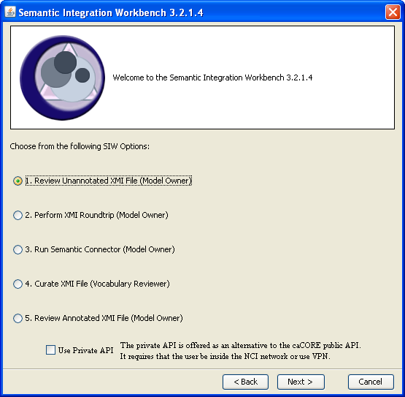
Semantic Integration Workbench (SIW): Options
The SIW provides 5 options.
For ‘new’ data services or applications we recommend you use options 1, 3 and 5

Slide 34
Semantic Integration Workbench (SIW): SIW Options:
Option 1 - Review Unannotated XMI File
Use this option first to review your UML model immediately after exporting XMI file from your modeling tool.
Finds modeling errors and missing tags so you can go back and correct any problems in the UML model prior to continuing.
UML Model errors include:
  Missing documentation tags.
  Missing description tags.
  Duplicated attributes.
  Missing or incorrect data types.
  Missing Value Domain tags.
  Missing association role names.
For ‘new’ data services or applications we recommend that you use this option as the first step in Semantic Integration before option 3 and 5.
Notes:
Use this option first to review your UML model immediately after exporting XMI file from your modeling tool.
Finds modeling errors and missing tags so you can go back and correct any problems in the UML model prior to continuing.
UML Model errors include:
Missing documentation tags.
Missing description tags.
Duplicated attributes.
Missing or incorrect data types.
Missing Value Domain tags.
Missing association role names.

Slide 35
Semantic Integration Workbench (SIW): SIW Options:
Option 3 - Run Semantic Connector
This option finds ALL possible concept matches from EVS for classes and attributes in your model.
The Semantic Connector (SC) uses pattern matching to find concepts.
  Each class and attribute name is parsed into words according to the camelCase (recommended best practice).
  Each word and group of words is searched in the NCI Thesaurus for possible matches.
For ‘new’ data services or applications we recommend that you use this option as the second step in Semantic Integration after option 1 and before option 5.
Process is simple you take your corrected “error free” XMI file from option 1, run through the SC and get a “First Pass” XMI file output to take to option 5.
Notes:
This is a simple process you take your xmi file checked and corrected for errors in option 1 and run

Slide 36
Semantic Integration Workbench (SIW): SIW Options:
Option 5 - Curate Annotated XMI File
Use Option 5 - Review Annotated XMI File to:
Map concepts, CDEs and Value Domains to the classes, attributes and associations in your model;
To verify your fully annotated model prior to submitting it to be loaded into the caDSR.
Do not use this option if you intend to let the EVS team figure out all the concept mapping.
  However, it is recommended that you give it a try, as a model owner you and your colleagues will have the best knowledge of your specific terms and concepts. EVS team will still check it.
  If you do let the EVS team do the mapping you can use this option to review the mappings later. Lets try it.
Notes:
Technically option 5 is optional you can stop at 3 and send to EVS team to do the mapping.
EVS team will then work with you to get the correct mappings. You can then just use this option to view and verify the EVS teams work.
The problem with either option is you need to get this right you need to get the scientists/developers/users of your data or application together make sure the semantics you or the EVS team assign are the best for your application. Sometimes this is not easy, EVS team might get it close but miss some specific detail/limitation of your data.

Slide 37
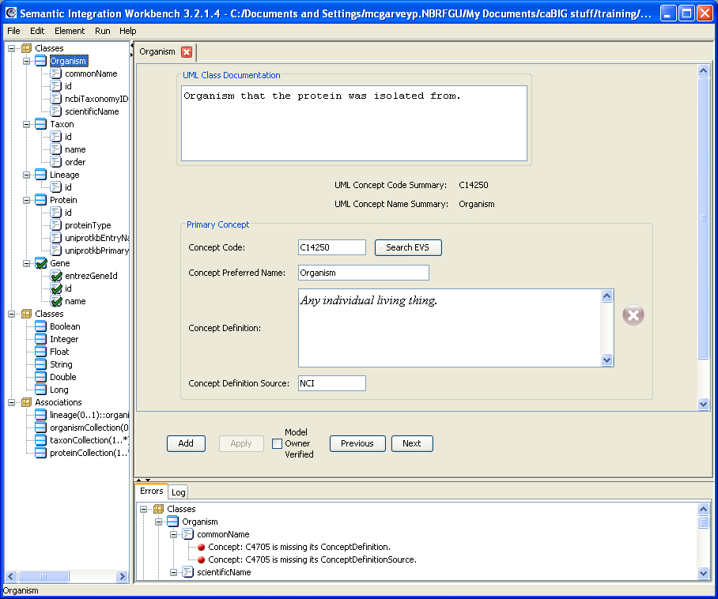
Semantic Integration Workbench: SIW Options:
Option 5 - Example
SIW Workbench Window
Editing Panes
Navigation
Pane
Errors/Logs

Slide 38
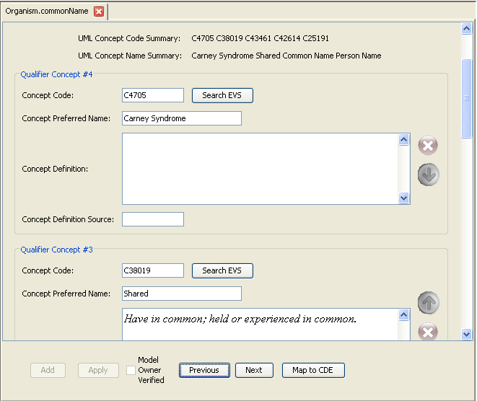
Semantic Integration Workbench: SIW Options:
Option 5 - Review Annotated Model:
Example – Review/Edit Concepts
Review & Edit EVS Concepts added by the Semantic Connector
Example shows SC found 5 EVS terms for “Organism.commonName”
“Shared, Common, Person Name, Name & Carney Syndrome”
3 do not apply here, delete them
2 apply “Common & Name”
Now we need to Check the Order

Slide 39
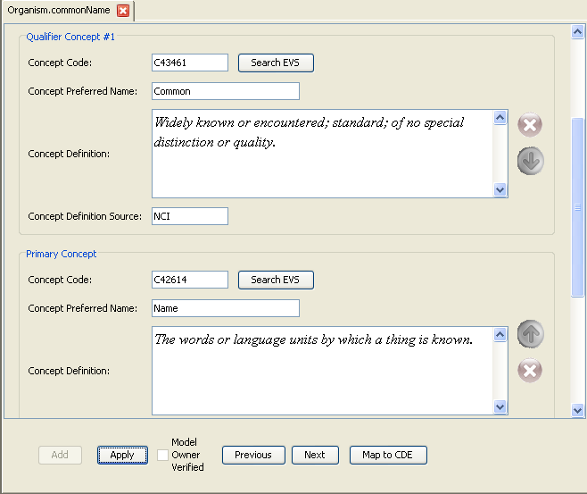
Semantic Integration Workbench: SIW Options:
Option 5 - Review Annotated Model:
Example – Review/Edit Concepts
Order the EVS Concepts
The order of concepts is important!
  Order changes the semantics. Example: “house dog” vs. “dog house”
    caDSR components with the same concepts in a different order are two DISTINCT components.
Here “Common” is listed as Primary Concept, “Name” as Qualifier Concept. This is incorrect
The Primary should be “Name”
(of the organism)
and “Common” is the qualifier
(type of name).
Click the Move this Concept up or down icons
(up and down arrows) next to concept to be moved.
Adjacent concepts swap position in the attribute.
Click the Apply button then Model owner Verified
checkbox

Slide 40
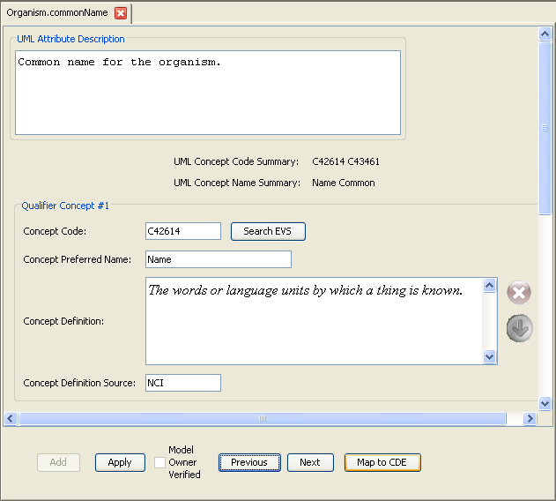
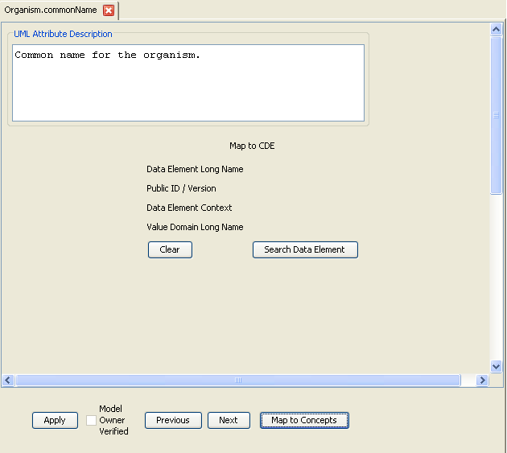
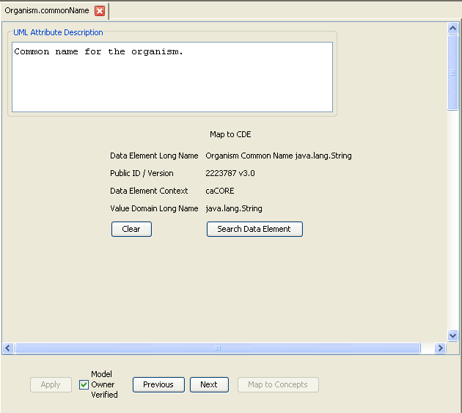
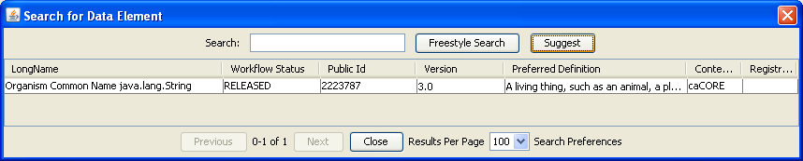
Semantic Integration Workbench (SIW): SIW Options:
Option 5 - Review Annotated Model:
Exercise - Map CDEs
You Can Use SIW To Find And Map An Attribute To An Existing CDE
Click the “Map to CDE” button.
(switches from concept editing to CDE mode)
Click the Search Data Element button.
Click Suggest (or search a term)
Double click on the desired CDE.
Click the Apply button.
Check Model Owner Verified

Slide 41
Conclusion
Semantic Integration is a series of steps to map UML components to EVS concept codes.
Semantic Integration is an essential piece of the caBIG™ goal of Semantic Interoperability.
  The Semantic Integration Workbench (SIW) is a software tool that adds semantic annotations to a UML model (via the XMI file).
  Learning the SIW options is an important step to building and maintaining an caBIG™ service.
Notes:
Remember real life “things” may have been modeled in other silver level compatible applications.

Slide 42
Lesson 3:
Transforming Model to caDSR Metadata

Slide 43
Transforming Model to caDSR Metadata
Notes:
Now we have an annotated model and we would like to it to get loaded to caDSR.

Slide 44
Outline
Introduction to resources and tools:
  Cancer Data Standards Repository (caDSR)
  UML Loader
UML Load submission process and package
Outcome

Slide 45
Cancer Data Standards Repository (caDSR)
Cancer Data Standards Repository (caDSR) is the database and tools used to house the metadata from caBIG™ UML models.
UML Class Diagrams form the basis for creating and registering semantically unambiguous caDSR metadata
In the caDSR, a data element corresponds to the combination of a semantically annotated class attribute.
UML Class | caDSR Data Element
Class | Object Class
Attribute | Property
Datatype (of the attribute) | Value Domain
data element
concept
representation
term
ISO/IEC 11179 compliant Data Element Concepts
Notes:
caBIG relies on the metadata housed in caDSR for interoperability.
The class/attribute combination forms the Data Element Concept. The class attribute datatype is represented as a Value Domain.

Slide 46

Cancer Data Standards Repository (caDSR)
UML Class
caDSR Data Element
Gene
Gene Name java.lang.String
- name: String
Gene Name
Gene
Name
java.lang.String
string
ISO/IEC 11179 compliant Data Element
Notes:
The ISO 11179 metamodel provides a very rich metadata model to use for semantic integration and semantic surfing later on

Slide 47
UML Loader
Used only by NCICB
  Run by NCICB Staff
Transforms UML Class Models into caDSR Metadata
  Uses the annotated XMI file from the Semantic Integration Workbench (SIW)
  Loads and registers UML-based metadata into the caDSR (classes, Data Elements, Value Domains, inheritance, associations, and class attributes)
Includes a self-harmonization process
  Creates new or re-uses existing caDSR Administered Components (e.g. Data Element, Value Domain, Object Class, Property) as needed
Java Application
Notes:
– the UML Loader simplifies the creation of this metadata.

Slide 48
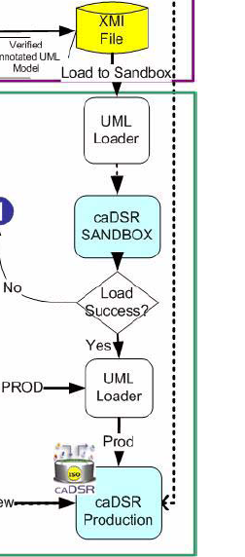


Submission Process
Submission
package
Verify concepts
Check errors
Curate concepts
NCICB Help Desk
Notify user
caDSR SandBox
Model Owner
NCICB Help Desk
Verify concepts
Check errors
Revised
Submission
package
NCICB Help Desk
Notes:
EVS curators may add new concepts to EVS.
This is an iterative process where model owner can check, correct and resubmit the package multiple times.

Slide 49
Submission Package
UML Model .EAP file
The original XMI file that exported from the UML model
The First Pass XMI file produced by running the Semantic Connector in SIW, if submitting the model to be annotated and verified by the EVS team, OR the (“Model Owner Verified”) Annotated XMI file, if submitting the model to be loaded to caDSR
A URL for Model documentation (e.g. EA generated)
The Completed Submission Form:
http://gforge.nci.nih.gov/docman/view.php/64/5460/submission_form_ModelName_vX_rvY.doc

Slide 50
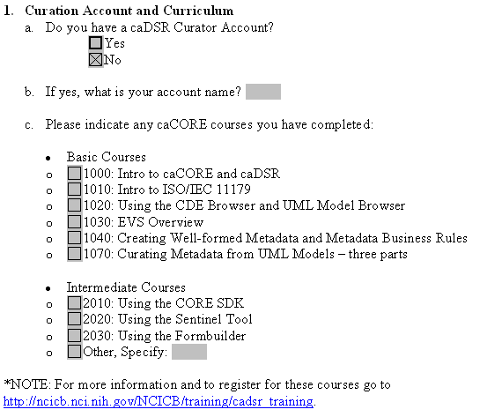
Submission Form
Notes:
Fill out the form. It basically provides background information on the model and model owner.
Identification information such as project name, version etc. and in which caDSR context model will be loaded.

Slide 51
Submission
When form and package are complete:
  Zip Submission package
  Modify extension of file from “.zip” to “.z”
  Send the zipped file to:
  NCICB Application Support (ncicb@pop.nci.nih.gov)

Slide 52
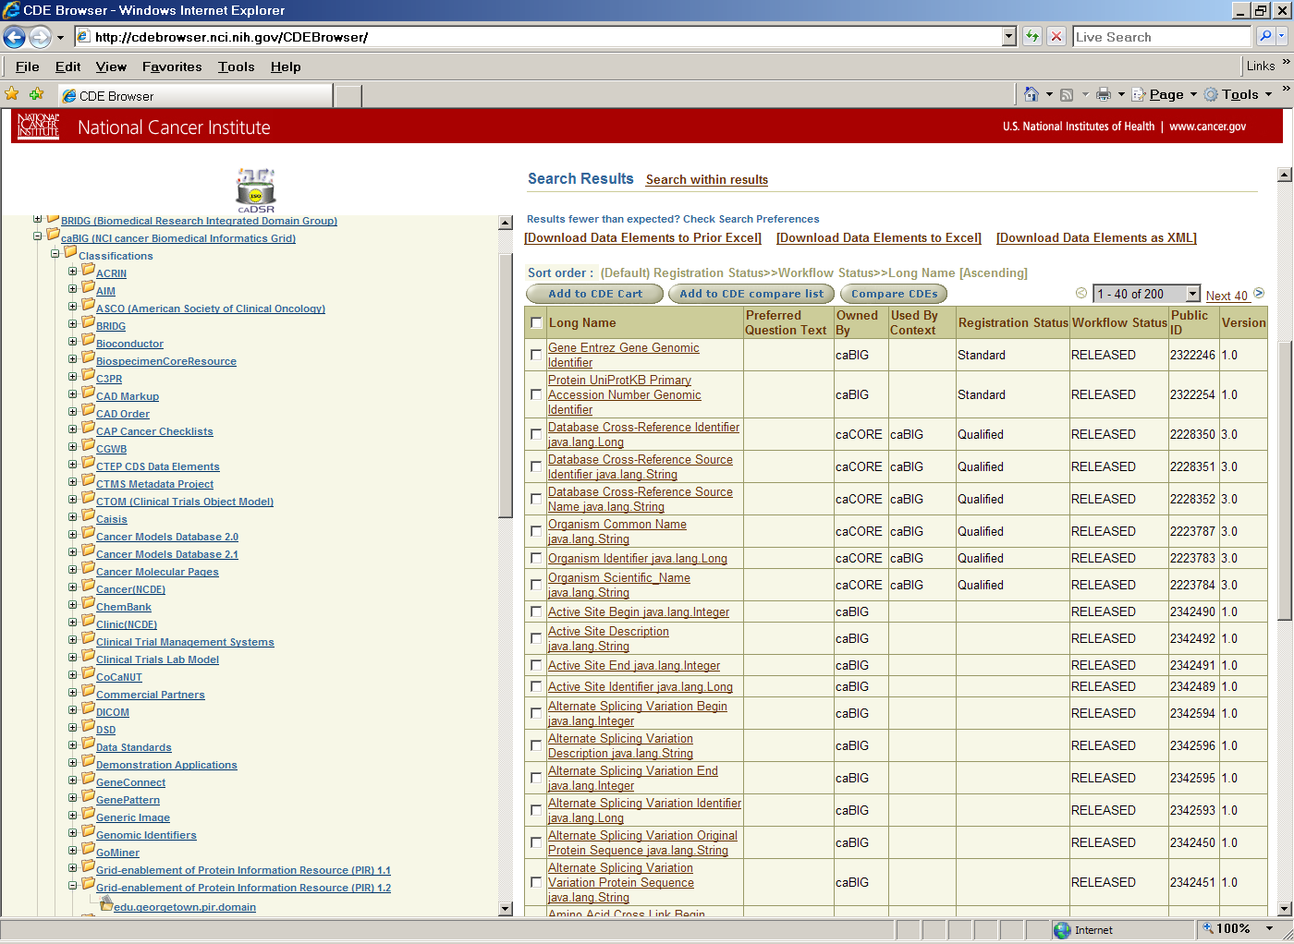
Outcome
Context
UML Project
UML Package
http://cdebrowser.nci.nih.gov/CDEBrowser/
Notes:
All caBIG funded projects go under caBIG context

Slide 53
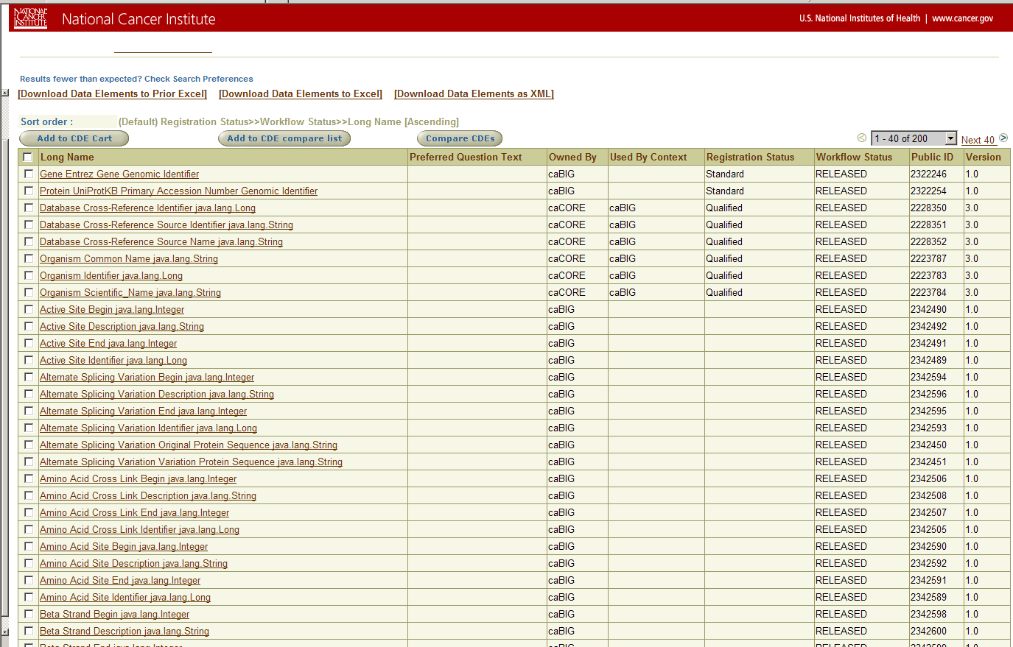
Outcome
Common Data Elements
Notes:
Point to “registration status” -> standards.

Slide 54
Additional Information
UML Loading Submission Package
http://gforge.nci.nih.gov/docman/view.php/64/5460/submission_form_ModelName_vX_rvY.doc
UML Model Projects Wiki
https://wiki.nci.nih.gov/display/CommonProjects/FAQs-UML+Modeling
Other Projects and Submission Packages
http://gforge.nci.nih.gov/frs/?group_id=64

Slide 55
Lesson 4:
Generating a caCORE-like System

Slide 56
Generating a caCORE-like System
Notes:
We have already seen SIW and UML loader. This section is for code generation.
We can generate the system anytime. However we prefer to generate on at the beginning before semantic annotation to test its “API-ability” and whether it meets use cases.
Final system can be generated after annotation. Code generation takes minutes if not seconds ☺

Slide 57
Outline
Introduction:
  caCORE-like System
  caCORE SDK
Using caCORE SDK to build your system

Slide 58
caCORE-like System
Based on an n-tier architecture
Uses an information model whose meaning is linked to EVS vocabularies and is registered in caDSR
Provides middleware between data and presentation
  Object-relational mapping (Hibernate)
  Data Access Objects
  Domain objects (Java Beans)
  Application Service
  Interfaces (Web services, HTTP remote)
  Utilities (logging, etc.)
Notes:
A n-tire architecture that has security, application service, ORM layers. Provides an abstraction of relational database via information models.
Presentation Tier
This is the topmost level of the application. The presentation tier displays information related to such services as browsing merchandise, purchasing, and shopping cart contents. It communicates with other tiers by outputting results to the browser/client tier and all other tiers in the network.
Application Tier (Business Logic/Logic Tier)
The logic tier is pulled out from the presentation tier and, as its own layer, it controls an application’s functionality by performing detailed processing.
Data Access Tier
Data Tier

Slide 59
caCORE Architecture
caCORE-Like Server
CSM
Java Client
HTTP
Java
Security
remoting
Application
Service
Layer
RDBMS
XML-HTTP
Client
HTTP
XML-HTTP
Data
Source
Delegation
Object-
Relational
Mapping
REST
Web Services
Client
RDBMS
HTTP
Web
Services
SOAP
Perl Client
Non-ORM
Mapping
HTTP
Non-
Relational
Data
Source
SOAP
Notes:
A n-tire architecture that has security, application service, ORM layers. Provides an abstraction of relational database via information models.
Presentation Tier
This is the topmost level of the application. The presentation tier displays information related to such services as browsing merchandise, purchasing, and shopping cart contents. It communicates with other tiers by outputting results to the browser/client tier and all other tiers in the network.
Application Tier (Business Logic/Logic Tier)
The logic tier is pulled out from the presentation tier and, as its own layer, it controls an application’s functionality by performing detailed processing.
Data Access Tier
Data Tier

Slide 60
caCORE SDK
Designed to aid in the creation of a silver level compliant caCORE-like system using a model driven approach
Developed by National Cancer Institute Center for Bioinformatics (NCICB)
Contains two modules:
  Code Generation Module which accepts a UML model as input and produces Java classes and other artifacts that can be used by standard client APIs to access data
  Middleware Module that provides the actual infrastructure and standard client APIs to access the underlying data system thru n-tier architecture
Notes:
It transforms a UML model into a working n-tier system.

Slide 61
Using caCORE SDK Code Generator to Build Your System
Overview of Process:
Configure properties
Configure object-to-relational mapping (ORM)
Build the system
Test the system
Notes:
No code at all.

Slide 62
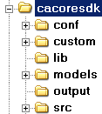
Using caCORE SDK Code Generator to Build Your System
caCORE SDK Directory Structure:
Configuration files
Custom beans or ORM files
Required libraries
UML models
Output (server/client files)
SDK source code

Slide 63
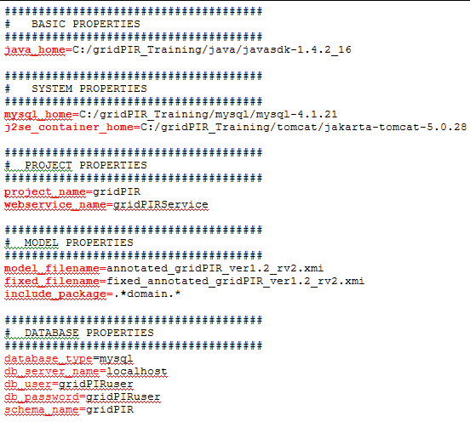
Configuring Properties
Properties files located in conf directory
Most important one deploy.properties
Software Directories
Project Identification
Model Information
Database Information
Notes:
Software Directory Tomcat, Ant, MySQL
Project Identification Names to be used for different services
Model information Filename (in models/xmi directory), Packages to include/exclude
Database information Schema name, Username / password, DDL / data dump filenames

Slide 64
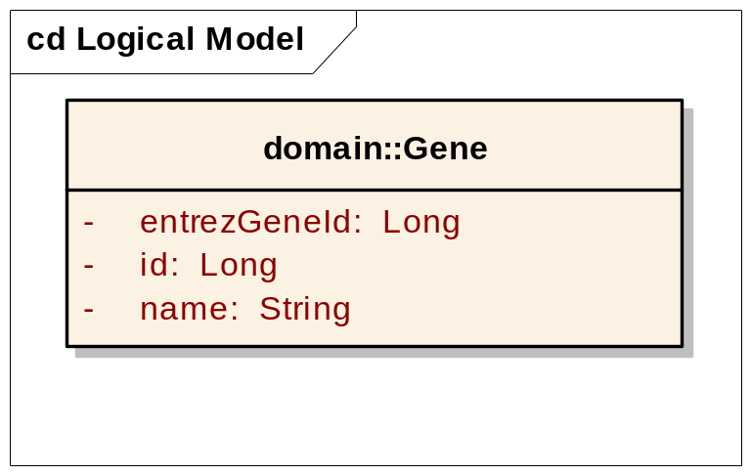
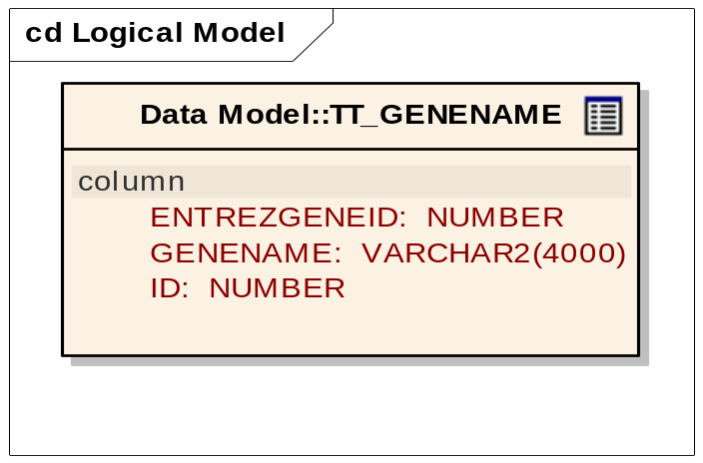
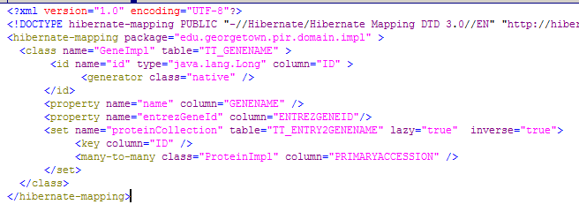
Configuring Object-to-Relational Mapping
Class
Database Table
Hibernate Mapping File

Slide 65
Configuring Object-to-Relational Mapping
Option 1: If you can model database schema (or reverse engineer one) in UML (XMI export), use caAdapter to map database tables to objects:
http://ncicb.nci.nih.gov/NCICB/infrastructure/cacore_overview/caadapter
and caCORE SDK generates Hibernate mapping files
Option 2: If you already have custom Hibernate mapping files or prefer to use other tools, put them in caCORE SDK “custom” folder to be consumed

Slide 66
Building the System
ant build-system
Compile SDK framework classes
Generate project source from UML model, templates (e.g. Java beans, XML schema)
Generate ORM configuration from model, templates or copy from custom folder
Create database schema and load data (optional)
Start database server (optiona) (e.g. MySQL)
Compile project code
Create system package (.war) and client jars
Deploy package and start J2EE container (e.g. Tomcat)
Notes:
Compile SDK framework classes
Run XMI pre-processor
Generate project source from model, templates (e.g. Java beans, XML schema)
Generate ORM configuration from model, templates or copy from custom folder
Create database schema and load data (optional)
Start database server (optiona) (e.g. MySQL)
Compile project code
Create system package (.war) and client jars
Deploy package and start J2EE container (e.g. Tomcat)

Slide 67
Testing the System:
Happy.jsp
Happy.jsp: a simple web interface to query deployed services
Deployed as a part of caCORE-like system generation
A good tool to test existence and general functionality of the service – not intended for production
Accessible from:
http://{HOST_URL}:[{PORT}]/{SERVICE_NAME}/Happy.jsp
e.g.: http://localhost:8080/gridPIR/Happy.jsp

Slide 68
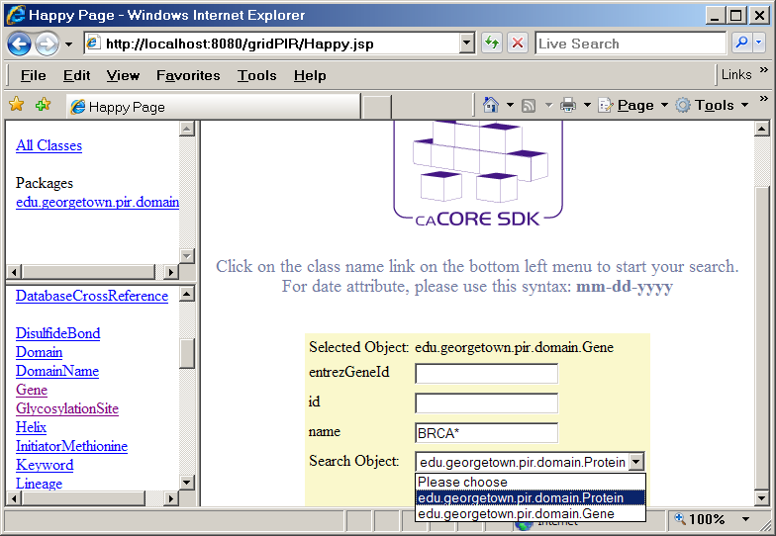
Happy.jsp
1. Select an object to use for search criteria
2. Set a criteria
(e.g. name = BRCA*)
3. Select a target object for search
Notes:
Panes contain Packages/Classes/Query Inteface

Slide 69
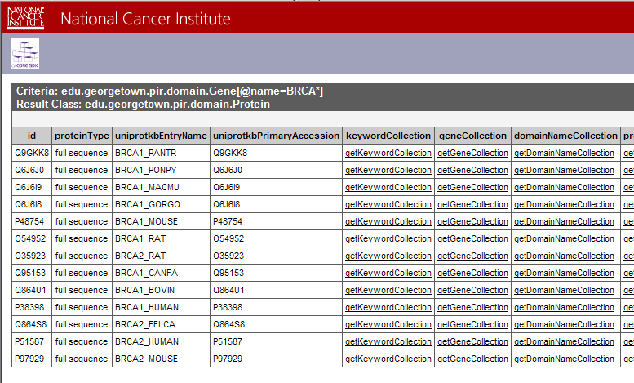
Happy.jsp
Results contain all methods/attributes for the objects meeting the criteria

Slide 70
Additional Information
caCORE SDK Web Site:
  http://ncicb.nci.nih.gov/infrastructure/cacoresdk
caAdapter User’s Guide:
  http://ncicb.nci.nih.gov/infrastructure/cacore_overview/caadapter/indexContent/docs/caAdapter_Documentation/content/ncicblfs/caAdapter/caAdapter_4_0/caAdapter%204.0%20Users%20Guide.pdf
Hibernate Documentation:
http://www.hibernate.org/hib_docs/v3/reference/en/html/

Slide 71
Lesson 5: Using a caCORE-like System

Slide 72
Outline
Introduction to query/search concept in caCORE-like systems
Programmatic Access to caCORE-like System:
  The ApplicationService interface

Slide 73
Introduction to query/search mechanism in caCORE-like systems
Employs an object-in/object-out mechanism
Uses query-by-example (QBE) format: the inputs to the query methods are themselves domain objects and they provide the criteria for the query
Allows traversal of the UML model
Basic order of operation:
  Ensure that the client application has knowledge of the objects in the information model
  Formulate the query criteria using the domain objects
  Submit the query objects to the server and specify the desired class of objects to be returned
  Use and manipulate the result set as desired
Notes:
QBE dates back to 70s developed by IBM.

Slide 74
ApplicationService Interface
Simple searches: One or more criteria objects from the domain model as inputs and return a collection of objects from the data repositories that meet the criteria
Nested searches: One or more criteria objects from the domain model but determine the type of objects in the result set by traversing a known path of associations from the domain model
Detached criteria searches: Hibernate detached criteria objects to provide a greater level of control over the results of a search (such as Boolean operations, ranges of values, etc.)
Hibernate Query Language (HQL) searches: HQL for the greatest flexibility in forming search criteria
caBIG™ Query Language (CQL) searches (will be covered in Session 3 today)

Slide 75
ApplicationService Example 0 : Creating a service instance
Create a remote ApplicationService instance
//URL for remote gridPIR instance(production)
String serviceURL="http://141.161.25.20:8080/gridPIR/http/remoteService”;
//Create the instance
ApplicationService appService = ApplicationServiceProvider.getRemoteInstance(serviceURL);

Slide 76
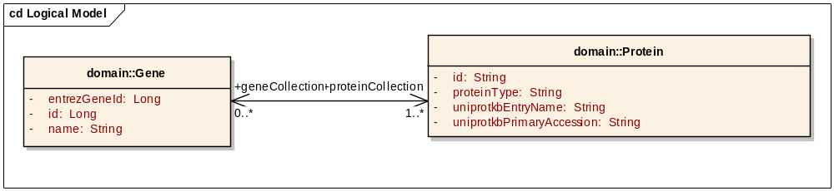
ApplicationService Example 1 : Query involving two associated classes
Find Protein objects for Breast cancer 1 gene (BRCA1):
Gene gene = new Gene();
//set criteria
gene.setName(“BRCA1”);
//invoke query
List resultList = appService.search(Protein.class, gene);
//process results
for (Iterator resultsIterator = resultList.iterator(); resultsIterator.hasNext();) { Protein returnedProtein = (Protein) resultsIterator.next();…
Notes:
We set the criteria here by creating a Gene object with name “BRCA1”
Knowing the association between “Gene” and “Protein” classes, we use this traversal path and set target class as “Protein”.
This could be impossible if “association” did not exist.

Slide 77
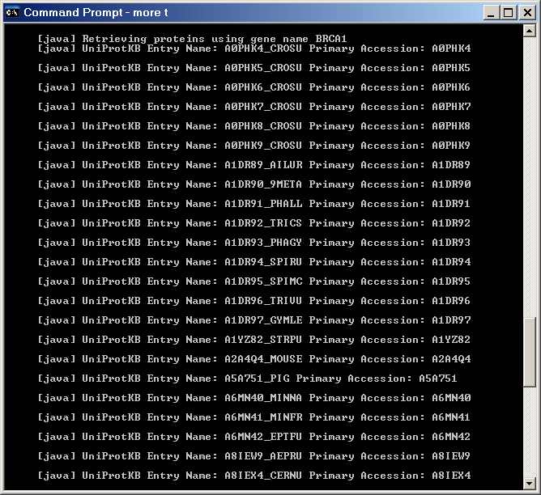
ApplicationService Example 1 : Query involving two associated classes
Results:

Slide 78
ApplicationService Example 2 : Query involving two associated classes
Results include BRCA1 from “African clawed frog”,
“Green puffer” and many more
What if we want to restrict it to Human BRCA1?

Slide 79
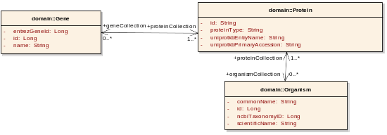
ApplicationService Example 2 : Query involving three classes
Find Protein objects for
Human Breast cancer 1 (BRCA1)
Gene gene = new Gene();
//set first criteria
gene.setName(“BRCA1”);
List geneCollection=new ArrayList();
geneCollection.add(gene);
//set second criteria
Organism organism = new Organism();
organism.setScientificName(“Homo Sapiens”);
List organismCollection=new ArrayList();
organismCollection.add(organism);

Slide 80
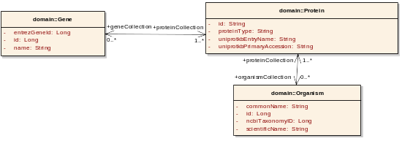
ApplicationService Example 2 : Query involving three classes
Find Protein objects for Human BRCA1 (cont’d)
// initialize protein object
Protein protein=new Protein();
protein.setGeneCollection(geneCollection);
protein.setOrganismCollection(organismCollection);
//invoke query
List resultList = appService.search(Protein.class, protein);
//process results
for (Iterator resultsIterator = resultList.iterator(); resultsIterator.hasNext();) {
Protein returnedProtein = (Protein) resultsIterator.next();

Slide 81
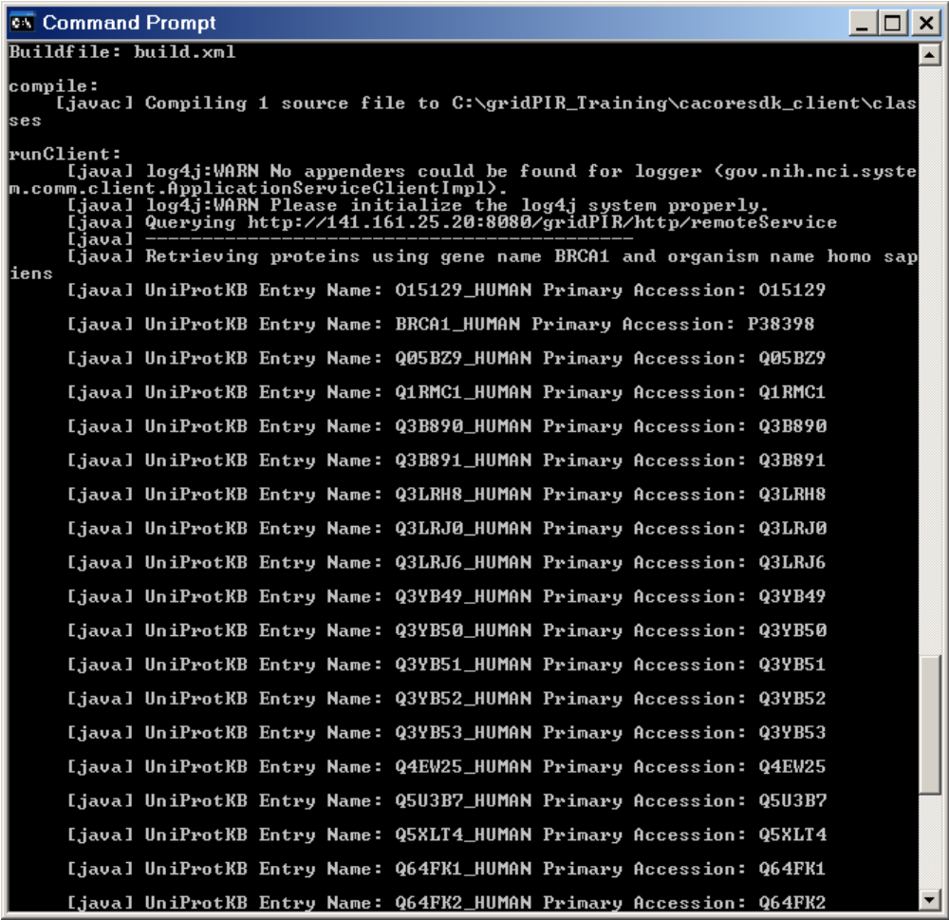
ApplicationService Example 2 : Query involving three classes
Results:

Slide 82
Additional Information
caCORE SDK Web Site:
  http://ncicb.nci.nih.gov/infrastructure/cacoresdk

Slide 83
Session II: Developing a Silver-Level Compatible Data Service API
Notes:
We covered steps of generation of a Silver-Level compatible data service API:
Information Modeling/Modeling your domain
Semantic Annotation
Loading Model to caDSR
Generating/using the API
We have seen the tools available to support these steps.
Session III will focus on deploying this data service on caGrid.

Slide 84
Questions

Slide 85
See you in Session III.
Notes:
So far we covered how to generate a silver level compatible API.

